Slide 1
Gender & Accent Recognizer From Audio
By:
Anuj Khasgiwala
Bhagyashree Mandora
Meiling Long

Slide 2
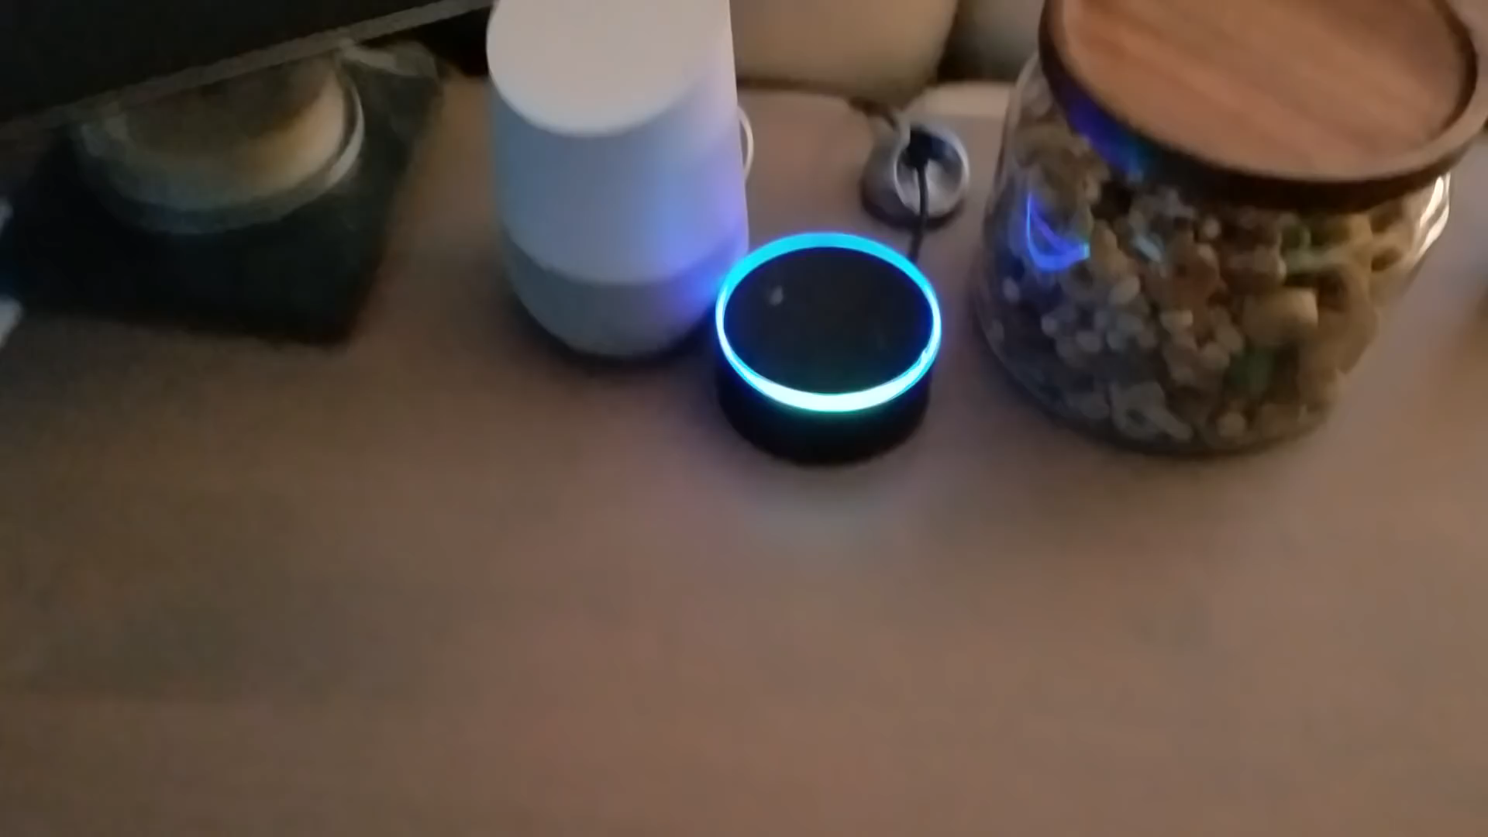

Slide 3
Motivation
Today, most of the businesses have introduced:
IVR services for taking orders and providing support to their customers
increasing focus on voice usage in smart systems like virtual assistants
Soon this will lead companies towards data analysis of voice inputs recorded to make audience specific business policies.

Slide 4
Problem Statement
In this project, we are creating an intelligent tool which would be able to predict characteristics of a person so that appropriate business decisions can be made using voice. We are focusing on gender and accent characteristics. This can be achieved by processing the sound waves from the wav file.

Slide 5
Approach
Data Collection
Scraped gender training and test data
Scraped accent training data for English
Data Processing
Transforming wav file to acoustic characteristics
Data Exploration
Finding importance of different acoustic characteristics to determine good candidates for prediction
Machine Learning
Used XGBoost, SVM, Random Forest and Neural Network models
Visualization

Slide 6
Results
Gender can be successfully predicted with more than 95% accuracy
Mean Fundamental Frequency is an important feature for classification with a value of 142 Hz as a boundary between male and f

Slide 7
Thank You

